Slide 1
Human Activity Recognition
https://www.yellowtrace.com.au/human-motion-sculpture/

Slide 2
WHAT you will see here
What is Human Activity Recognition
Data generation
Data Exploration
Chosen model and why
Results and interpretation

Slide 3
WHAT IS HAR?
HUMAN ACTIVITY RECOGNITION (HAR)
The procedure of recording, processing and analysing human movements for the purpose of identifying specific movements of a person based on sensor data.

Slide 4
LET’S GENERATE data
4 MOVEMENTS
the duration of each movement
repetition of each movement

Slide 5
SAMBA
WALKING
https://www.hindustantimes.com/fitness/walking-regularly-for-40-minutes-makes-your-heart-stronger-here-s-what-science-says/story-0Xi8lSlSBma8uhkxFwbsYI.html
chosen movements
SALSA
WALKING DOWNSTAIRS
https://www.everydayhealth.com/specialists/healthy-living/benefits-of-going-down-stairs/

Slide 6
1 minute/movement
10 times/movement
lET’S DANCE

Slide 7
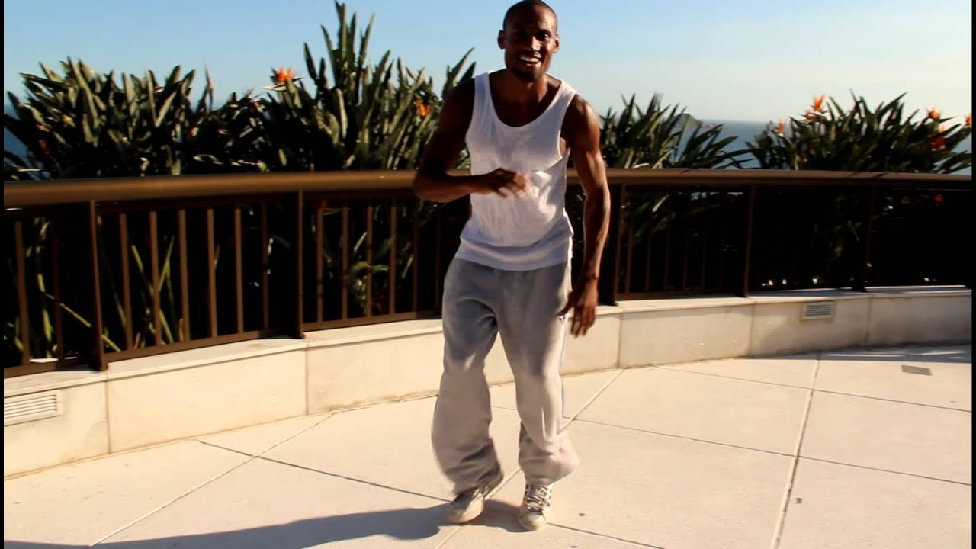
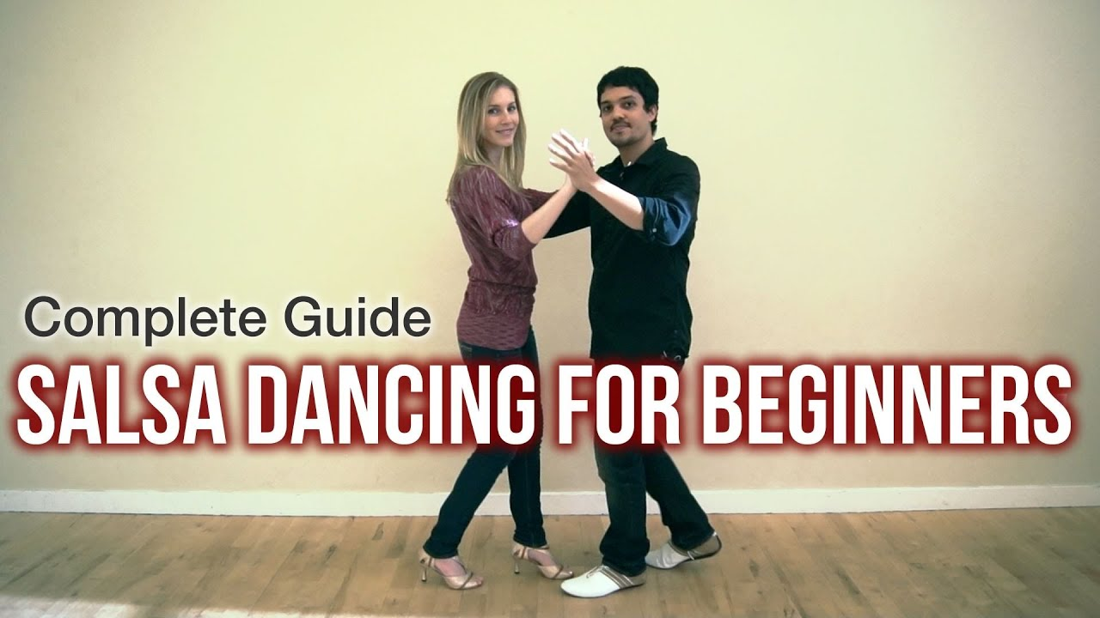

Slide 8
how we recorded the data
+
+
10 times/movement during 1 min
collect data
PROCESS data

Slide 9
How could we work together?
storing
data
coding
together

Slide 10
dataset to start coding
g-Force Linear Accelerometer Gyroscope
time | gFx | gFy | gFz | ax | ay | az | wx | wy | wz
(9 variables x 7 measurements) + label = 54 variables
std | max | min | mean | mean_number_of_peaks | max_min | sum_abs | label

Slide 11
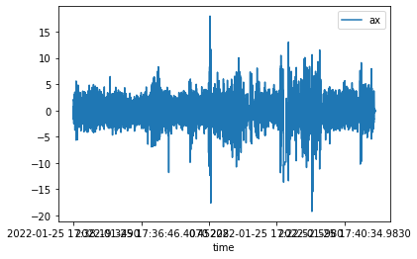
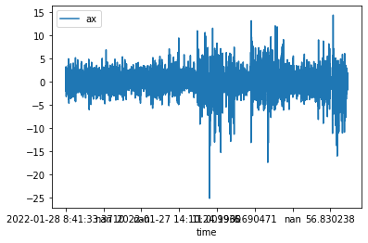
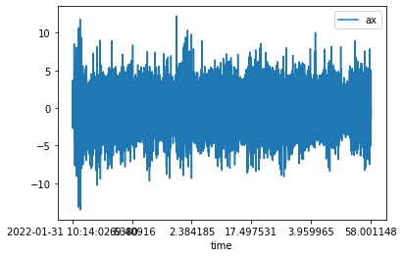
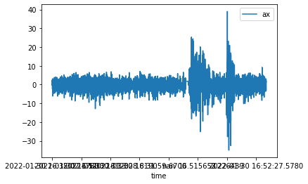
data exploration
WALKING
WALKING DOWNSTAIRS
SALSA
samba

Slide 12
model chosen
We choose this model because…

Slide 13
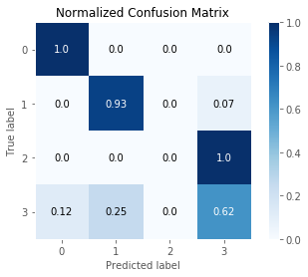
results
ACCURACY: 80%
CONFUSION MATRIX
Precision:
Recall:

Slide 14
interpretation
Which movement the model predicted best
How the model differentiated the two dance styles
What could still be improved in the model

Slide 15
THANK YOU!

Slide 16
CHALLENGES
We would deal with a great amount of data (every observation in the dataset is a summary of many records through time).
Working together on this project was not an easy task.

